Slide 1
Properties of People (Part I)
Add Fitts’ Law captcha
Add administrivia
Programming Usable Interfaces (PUI)
Jason Hong
jasonh@cs.cmu.edu
Notes:
Video to load: http://www.youtube.com/watch?v=pPKymEC_Hss

Slide 2
Overview
Today and next time
Human factors issues and how they affect design and implementation of systems
Today
Good and Bad Use of Color
Fitts’ Law
Gulf of Execution / Evaluation

Slide 3
Why Study Color?
Color can be a powerful tool to improve user interfaces by communicating key information
Inappropriate use of color can severely reduce the performance of systems we build
Note: for visual designers in the room, please feel free to add to discussion
Notes:
3

Slide 4
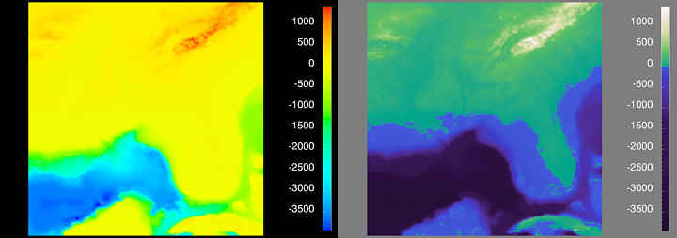
Pop Quiz: What does this image show?
Notes:
Ok next topic: color.
Example from http://www.research.ibm.com/people/l/lloydt/color/color.HTM

Slide 5
Bad and Good Use of Color
Example on last slide
(Don’t look yet)
Why is the left’s color choice poor? What makes the right side better?
Notes:
So why is the color choice poor?
No mapping of color (note on right how blues are used for water, and greens for land)
Color is better if you adjust by saturation (purity) or value (brightness) rather than hue (rough color, ie red, green, blue, orange) for mapping. People can more easily see and compare differences in saturation and value over hue. Also, changes in hue don’t naturally map to a scale, whereas saturation and value do.
There is tons more to know about good use of color. For not, the simplest thing to do is to look for existing color palettes, and just those. That should account for the vast majority of your needs for colors. There is also red-green color blindness too. Simplest thing to do is to turn your screens into greyscale, and see if you can see differences.

Slide 6
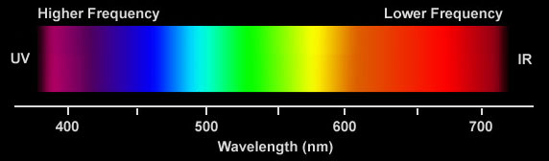
Visible Spectrum
Notes:
6

Slide 7
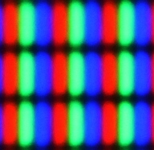
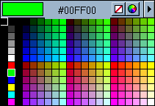
RGB: A Technology-Centered Color Model
Color typically programmed thru RGB
Same as web CSS color specifications
Your LCD monitors use RGB too
However, does not match how we normally think about colors
Ex. Artists
Ex. Visual designers
Ex. Interior designers

Slide 8
HSV Color Model
Hue
What we normally think of as color
Ex. Red, blue, yellow, green
Saturation
Purity of the hue, e.g. red more saturated than pink
Color is mixture of pure hue and achromatic
Achromatic: white, gray, or black
Value (or Lightness or Brightness)
How much light appears to be reflected from a surface
Some hues inherently lighter (yellow) or darker (blue)

Slide 9
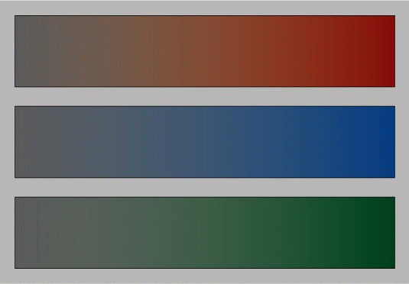
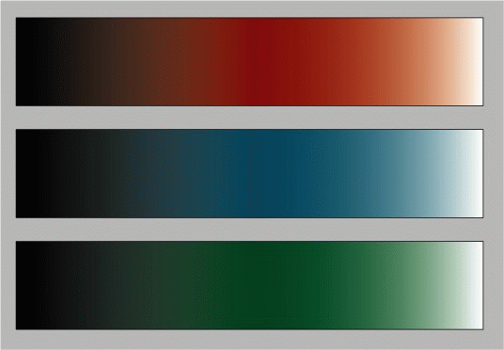
Color Components
Saturation
Value
from http://www2.ncsu.edu/scivis/lessons/colormodels/color_models2.html#saturation

Slide 10
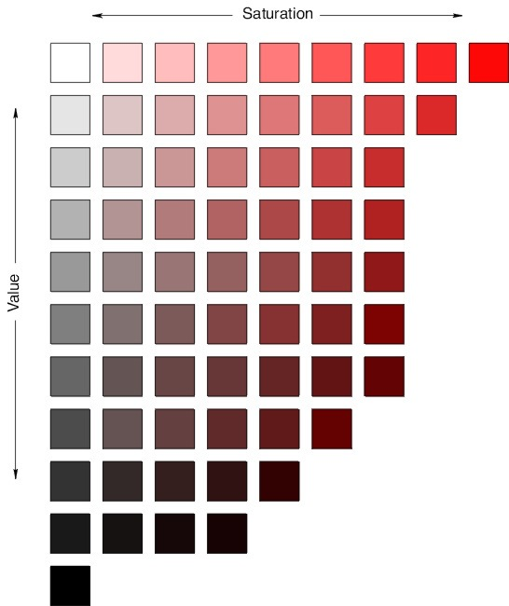

Slide 11
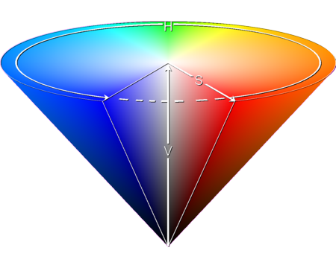
Visualization of HSV Color Space

Slide 12
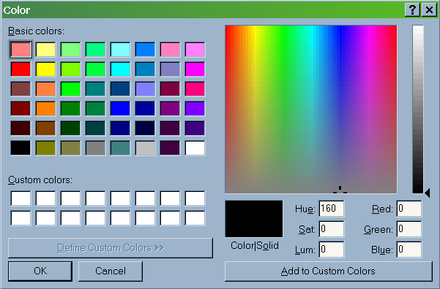
Can Convert RGB to HSV and Back
Notes:
Both RGB and HSV are equivalent
Bottom-right is a useful hsv color chooser that also lets you do rgb

Slide 13
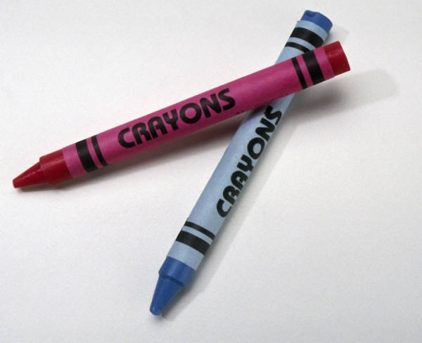
Color Model Summary
RGB easy to program
Close to hardware
Universally supported on all platforms
HSV is easier for people to use
Uses people’s intuition of what color is
There is a direct conversion to RGB
Other colors models:
CMYK: mixing pigments cyan, magenta, yellow, and black (printing)

Slide 14
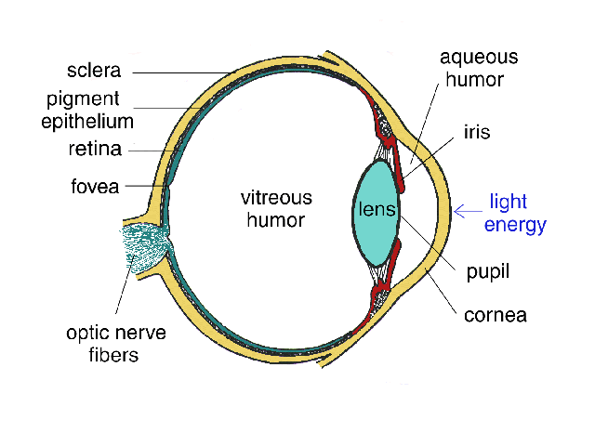
Human Visual System
Notes:
14
Light passes through lens and is focused on retina

Slide 15
Retina
Retina covered with light-sensitive receptors
Rods
Primarily for night vision and perceiving movement
Sense intensity or shades of gray
Can’t discriminate between colors
~75M – 150M rods
Cones
Used to sense color
~4.5M – 7M cones
Note: Many, many more rods than cones

Slide 16
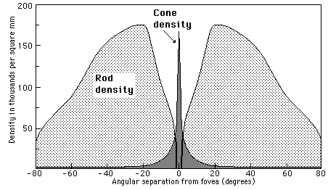
Distribution of Cones and Rods
Center of retina has most of the cones
Allows for high acuity of objects focused at center of your vision (about 10-15 degrees)
Ex. if looking here, can’t read text on bottom easily
Fovea ~2 degrees
About size of thumb with extended arm
Notes:
http://hyperphysics.phy-astr.gsu.edu/hbase/vision/rodcone.html

Slide 17
Distribution of Cones and Rods
Edge of retina is dominated by rods
Allows detecting motion (threats) in periphery
This is also why animated ads are so distracting

Slide 18
Color Perception via Cones
“Photopigments” used to sense color
3 types: blue, green, “red” (really yellow)
Each sensitive to different band of spectrum
Ratio of neural activity of the 3 → color
Other colors perceived by combining stimulation
Notes:
18

Slide 19
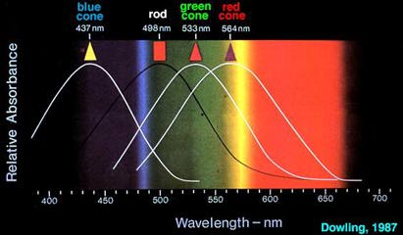
Color Sensitivity
Really yellow
from http://insight.med.utah.edu/Webvision/index.html
Notes:
19
http://insight.med.utah.edu/Webvision/index.html

Slide 20
Design Tip #1 Don’t Rely on Blue for Small Objects
Photopigments not distributed evenly
Mainly reds (64%) & few blues (2-4%)
So we are less sensitive to short wavelengths (blue)
Few blue cones in fovea
Harder to see small blue objects you fixate on
Blue text also slightly harder to read
So blue hyperlinks as default is worst choice
Note: strong contrast >> avoiding blue
Some text here
Some text here

Slide 21
Design Tip #2 Don’t Rely on Blue for Older Users
As we age, our lens yellows and absorbs shorter wavelengths
Sensitivity to blue is even more reduced

Slide 22
Design Tip #3 Minimize saturated colors
Different wavelengths of light focus at different distances behind eye’s lens
If your GUI has lots of reds and blues, will force lots of refocusing and cause fatigue
Design Implication
Pure (saturated) colors require more focusing than less pure (desaturated, pastel)
Avoid saturated colors in UIs unless really need something to stand out (stop sign)

Slide 23

Color Guidelines
Notes:
23
Saturated -> Pastels

Slide 24
Color Deficiency (also known as “color blindness”)
Trouble discriminating colors
About 8% of males, 0.5% of females
Why should you know this?
Two main types
Different photopigment response is common
Reduces capability to discern small color diffs
Red-green deficiency is most common
Lack of either green or red photopigment → can’t discriminate colors dependent on R & G
More rare are blue-yellow and total color blindness

Slide 25
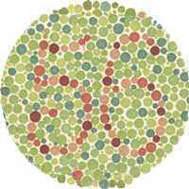
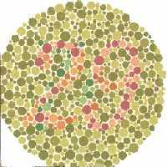
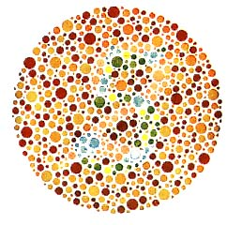
Ishihara Test for Color Blindness
If you can’t see numbers, don’t worry
Projectors, LCD screens, CRT, and print all have different dynamic ranges, hard to get them to match
Lots of UI color blindness simulators out there

Slide 26
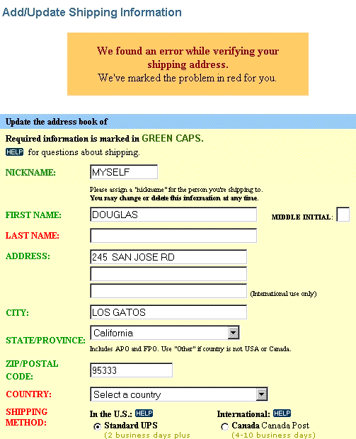
Color Deficiency Example

Slide 27
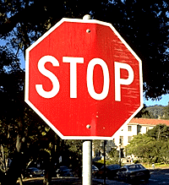
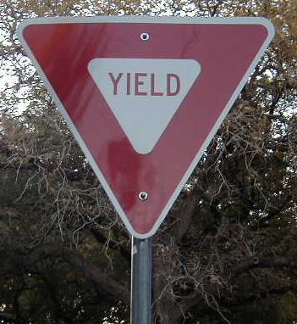
Design Tip #4 Don’t Rely Solely on Hue (color deficiencies)
Use mixtures of colors (red / green issues)
Also have contrast in intensity
Consider having redundant cues too
What redundant cues used for traffic signs?
Notes:
Traffic signs have multiple cues: color, word, shape

Slide 28
Design Tip #5 Design your UIs in grayscale first
Focus on value over hue or saturation
This will help ensure visibility
Keep luminance / intensity / value the same from grayscale when moving to color
Can also do this in reverse
To evaluate visibility for people with poor vision, convert screenshot of your UI into greyscale

Slide 29
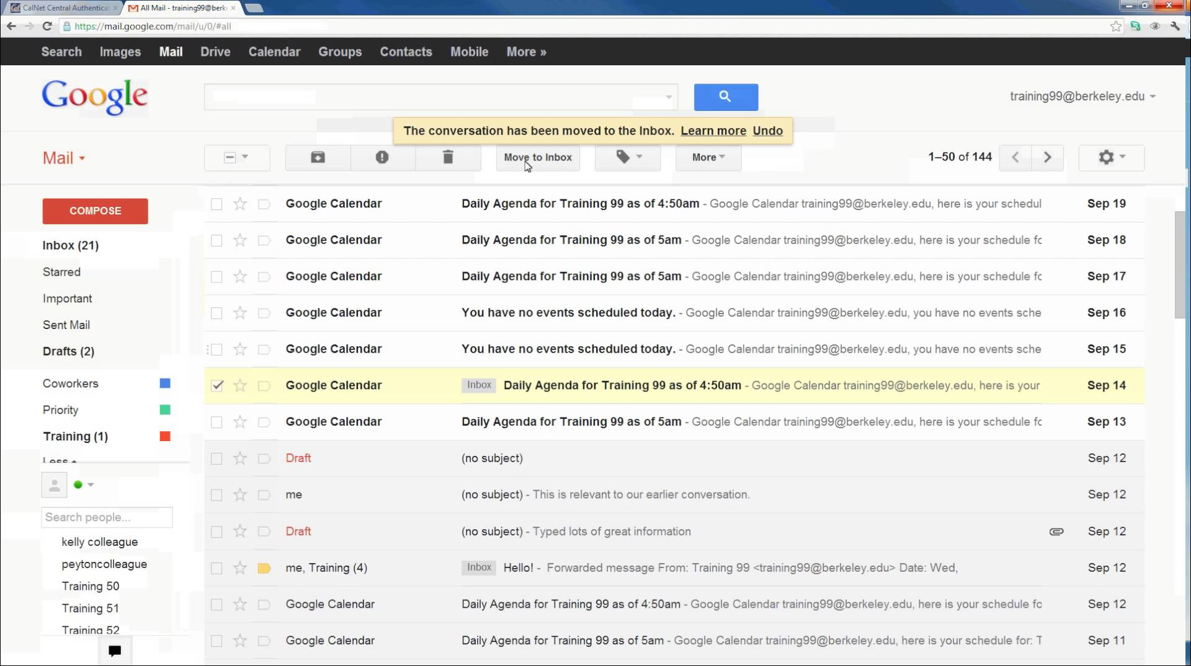

Slide 31
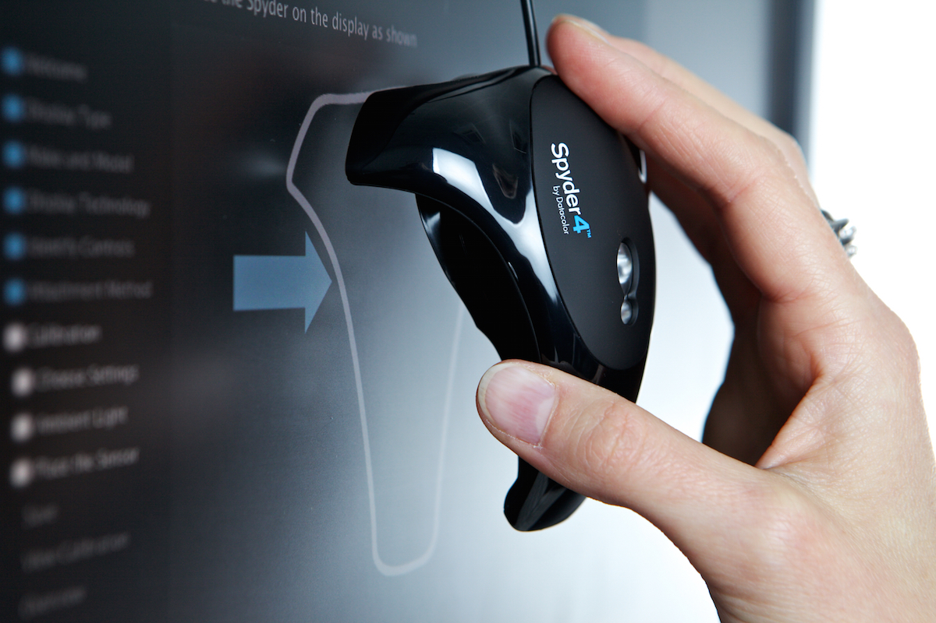
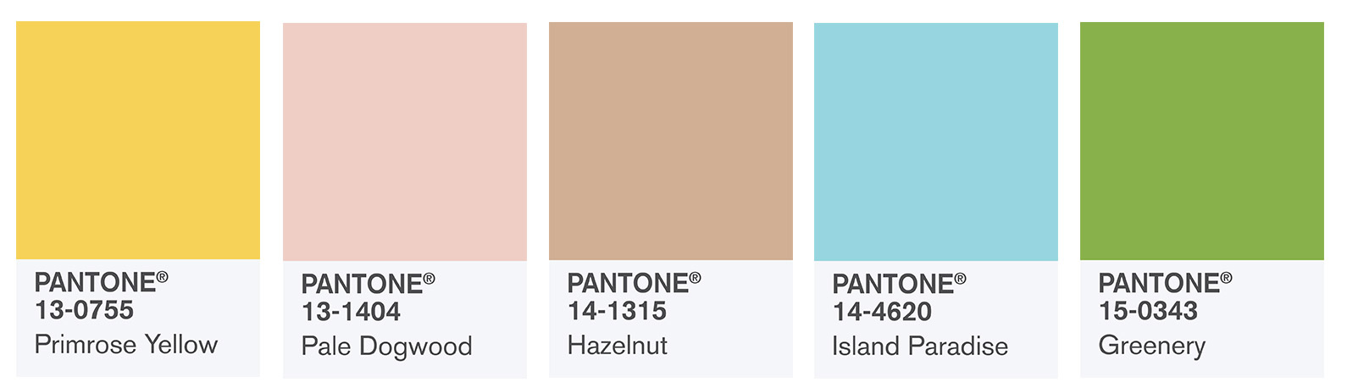
Aside: Proper Colors
Color calibrators or colorimeters
Pantone colors for physical things

Slide 32
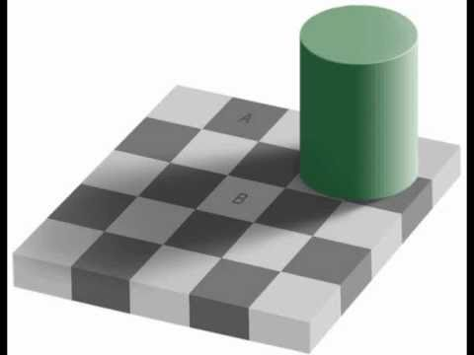
Perception of Color is Not the Same as Displayed Color

Slide 33
Perception of Color is Not the Same as Displayed Color

Slide 34
Some Questions For Class
In Java, CSS, and other GUI programming, color is 24 bit (+ 8 bits for alpha transparency)
So 8 bits for each of red, green, blue
Why not more bits?
Why not 64 bit color?
Notes:
Humans can’t really see much more colors

Slide 35
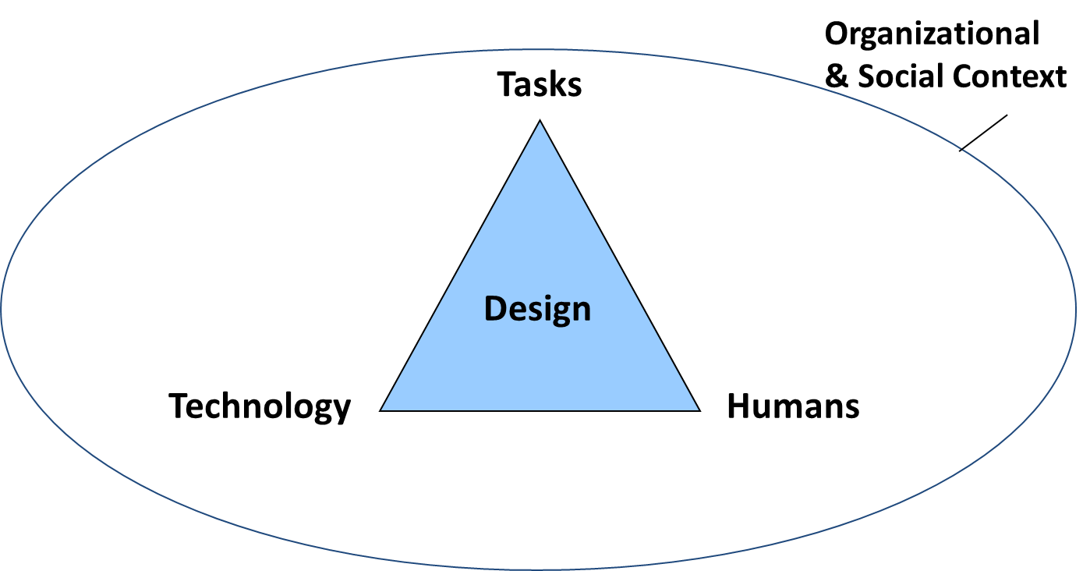
Human Physiology Drives Design
Visuals
Number of colors
Pixel size (retina displays)
Audio
20 – 20,000 Hz
Telephone 4 kHz
Cursor
Mouse or finger
Vs neck or foot

Slide 36
Two Interesting Color Factoids
Some women have a fourth type of cone
Estimates are ~12% women
Some ofyou may be able to see more colors than ordinary humans
In old days, used to only have 8-bit color (instead of 24-bit RGB + 8-bit alpha today)
Had 3 bits for red, 3 for green, 2 for blue
Again b/c human eye less sensitive to blue

Slide 37
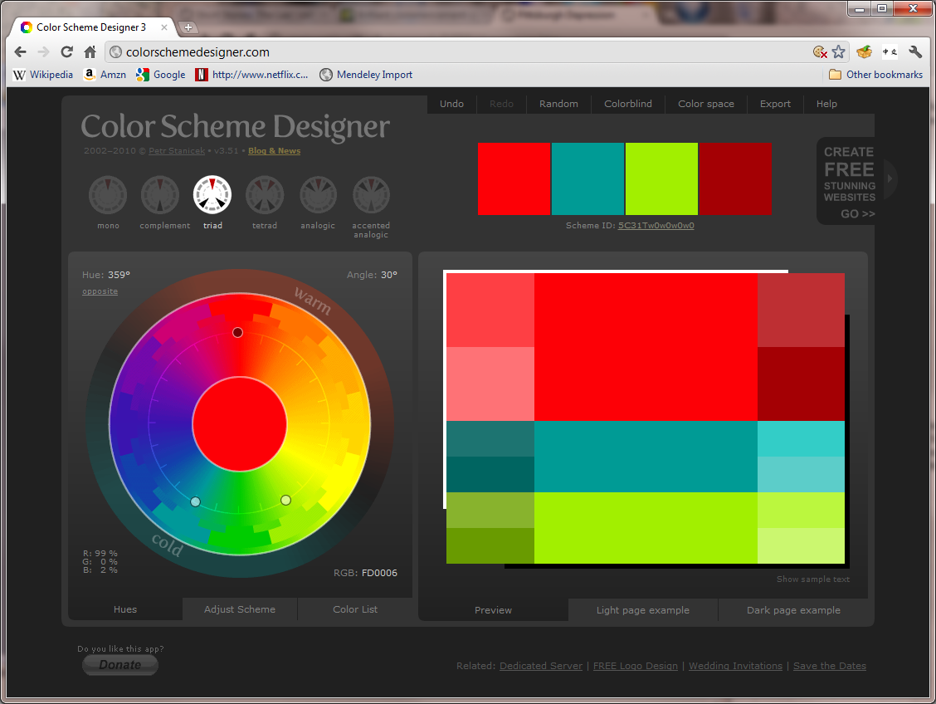
Design Tips
Notes:
If you need color help, can use lots of online tools
http://colorschemedesigner.com/csd-3.5/

Slide 38
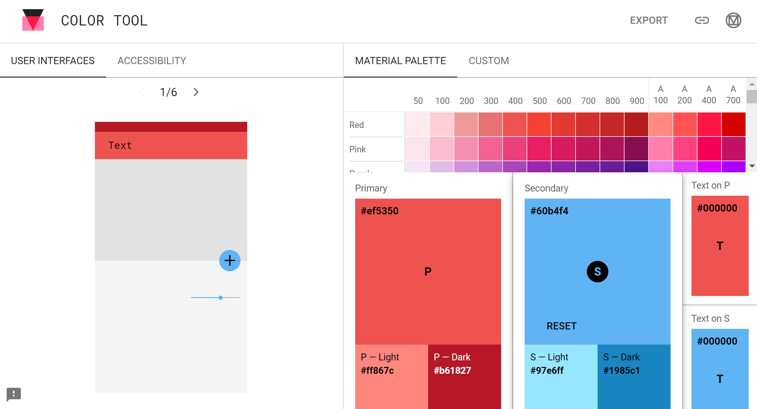
Material Design Color Tool
https://material.io/color/
Notes:
https://material.io/color/

Slide 39
Recap of Design Tips
Don’t rely on blue for small objects
Don’t rely on blue for older users
Minimize use of saturated colors
Don’t rely solely on hue (color deficiencies)
Design your UIs in grayscale first

Slide 40
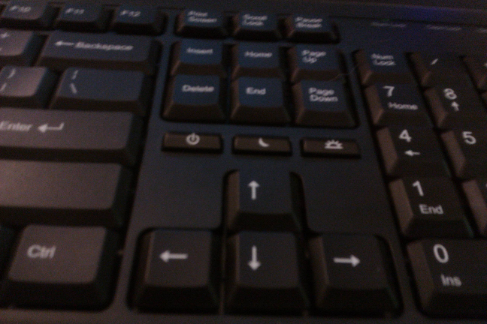
What’s Wrong Here?
Notes:
Ack!!!! Buttons for power and sleep on this laptop are right next to the delete and arrow buttons. Very dangerous, very error prone.

Slide 41

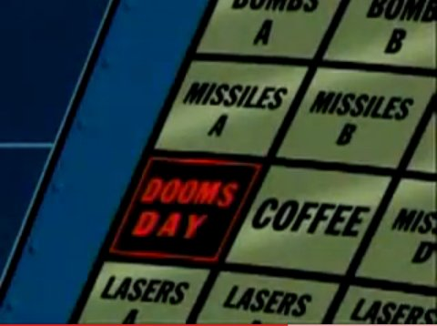
Silliest Video You Will See All Week
http://www.youtube.com/watch?v=pPKymEC_Hss
Notes:
Here is another (silly) example of preventing errors.
This will likely be the stupidest video you see this week, but it’s also a great example of bad design. How might we prevent this?

Slide 42
How to Prevent These Problems?
Notes:
Basically, make it harder to hit “Doomsday” button (or far easier to hit Coffee)
Examples: add safety locks, increase distance (ie don’t have coffee next to Doomsday button), make coffee button bigger, etc.

Slide 43
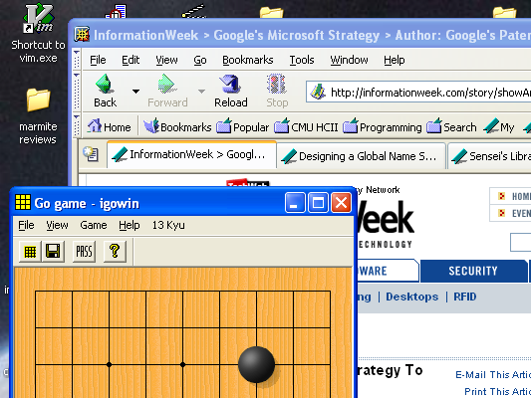
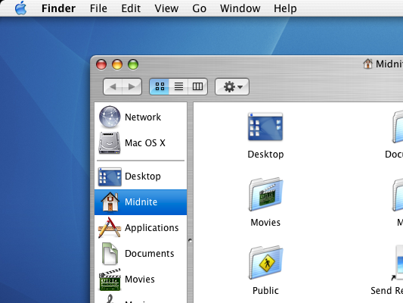
Fitts’ Law
Intuitively, things that are closer and/or bigger are faster and easier to hit (and vice versa)
Ex. Windows menus vs. Mac menus
Note different placing, what effect is there?
Notes:
These two examples are examples of Fitts’ Law. The basic idea is that, for any pointing device (mouse, finger, stylus, etc), things that are close and/or big are faster and easier to hit than things that are far and/or small. Simple idea, but lots of surprising examples of this principle in user interfaces.
Windows menus at top of windows, vs. Mac menus at top of screen
Interesting Fitts’ law effect
Thin vertical target (dir of move) → high required accuracy
Hard to pick
But both menus are thin vertical targets…
With menu at top of screen can overshoot by an arbitrary amount
Example of a “barrier” technique
For example, windows menus vs mac menus. How might Fitts’ law play out here?
Note that Mac menus are at the edge, and the edge is essentially infinite size. That is, there’s a barrier, and you can’t overshoot it. In contrast, if you watch windows menus, people tend to overshoot it to get there, slow down, overshoot again, and then hit the target (this happens pretty quickly though). So in practice, Mac menus should be faster.

Slide 44
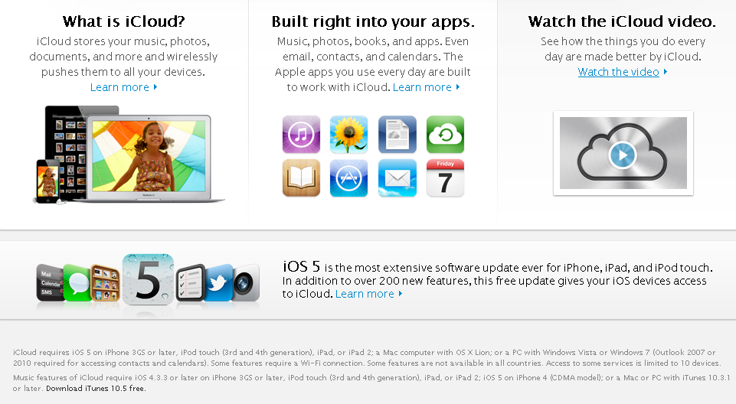
Good Example of Fitts’ Law
Notes:
Picture is from Apple’s web page. Note that this page doesn’t exist anymore.
Another good example of Fitts’ Law. Note that if you mouse over anywhere in the box of “Watch the iCloud video” the entire thing highlights. Much bigger target. Much bigger. Much wow.

Slide 45
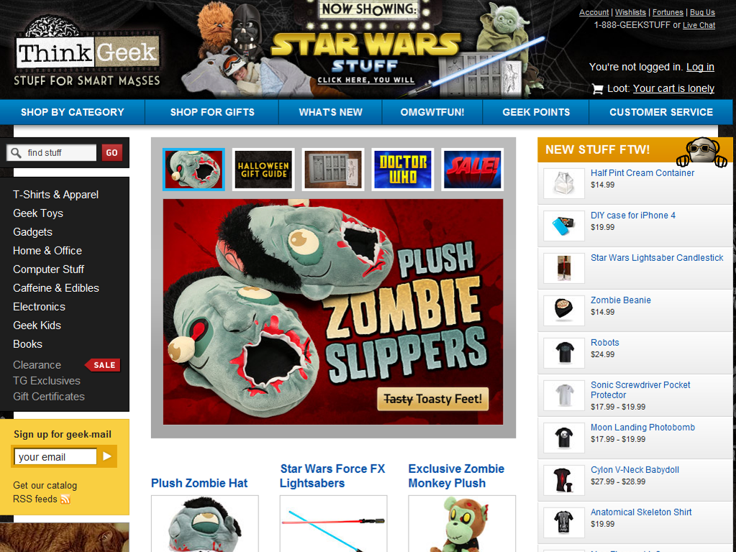
Another Fitts’ Law Example
Notes:
Picture is from Thinkgeek’s web site.
Thinkgeek website lets you mouseover any part of an item in “New Stuff” and it highlights the item. Same with menus on the left. Good design, good use of Fitts’ law. Another related aspect of Fitts’ Law here is grouping logical things together. For example, can’t accidentally click on the menu items on the left if looking at things on the right.

Slide 46
Fitts’ Law
Fitts’ law tells us about difficulty for pointing and selection tasks
Predicts time to make a movement
Moving hand is a series of micro-corrections
Time = A + B*log₂(Dist / Size + 1)
A and B are empirically derived constants
Time to move the hand depends only on relative precision required

Slide 47
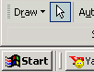
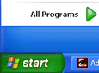
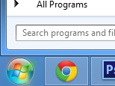
So Why Does Fitts’ Law Matter? (1/5)
Subtle source of usability bugs
What’s interesting about Windows 95 start menu?
Windows 95
Windows XP
Windows 8
Notes:
Windows 95 bug: bottom-left corner is offset by a few pixels, can’t click on it
Windows XP fixes it by making Start button go all the way to the corner
Windows 8 uses styling to make start menu circular, but still makes entire corner clickable

Slide 48
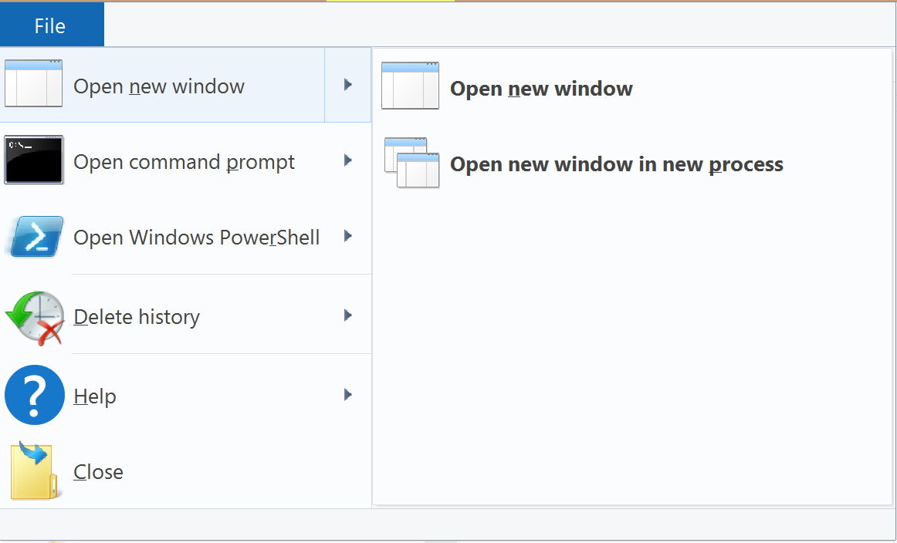
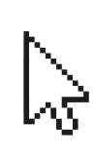
So Why Does Fitts’ Law Matter? (2/5)
Subtle source of usability bugs
What’s the potential usability problem here?
Notes:
This is a Fitts’ Law issue b/c it’s a steering task that requires you to be precise (which is a variant of Fitts’ Law)

Slide 49
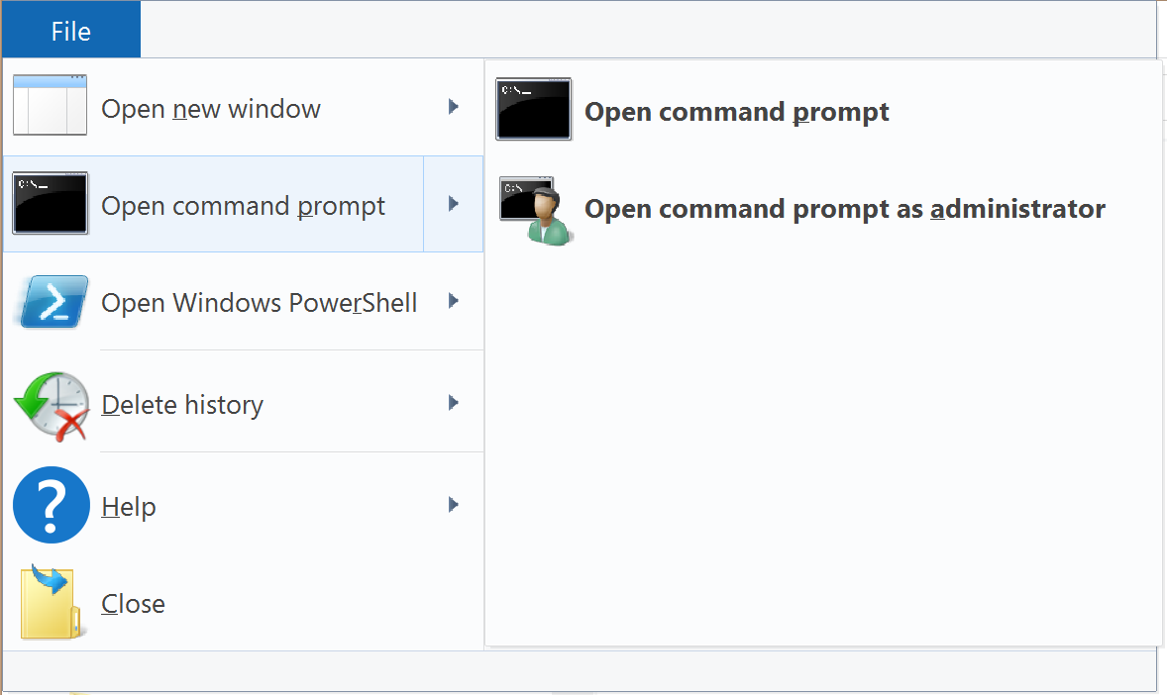
So Why Does Fitts’ Law Matter? (3/5)
Overly eager cascading menus, wrong submenu
Common problem w/ web menus (but not Mac or Win)
Notes:
Note that Google Docs has this problem too

Slide 50
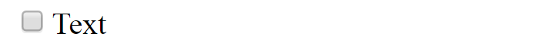
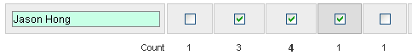
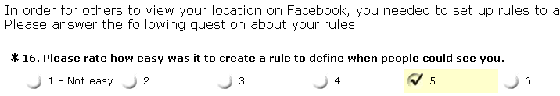
So Why Does Fitts’ Law Matter? (4/5)
Can improve usability by making objects have “bigger” target size
Ex. Putting things in corners
Ex. Making entire label clickable in HTML
<label><input type="checkbox"/>Txt</label>
Notes:
Doodle has bigger virtual targets
SurveyMonkey has bigger virtual targets too

Slide 51
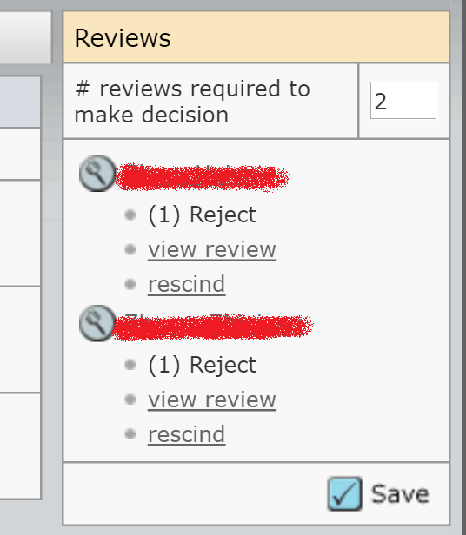
So Why Does Fitts’ Law Matter? (5/5)
Conversely, can prevent errors by making target size smaller or further away
Or generally by increasing difficulty of hitting target
Notes:
Example is from Manuscript Central

Slide 52
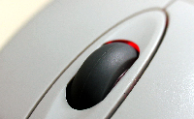
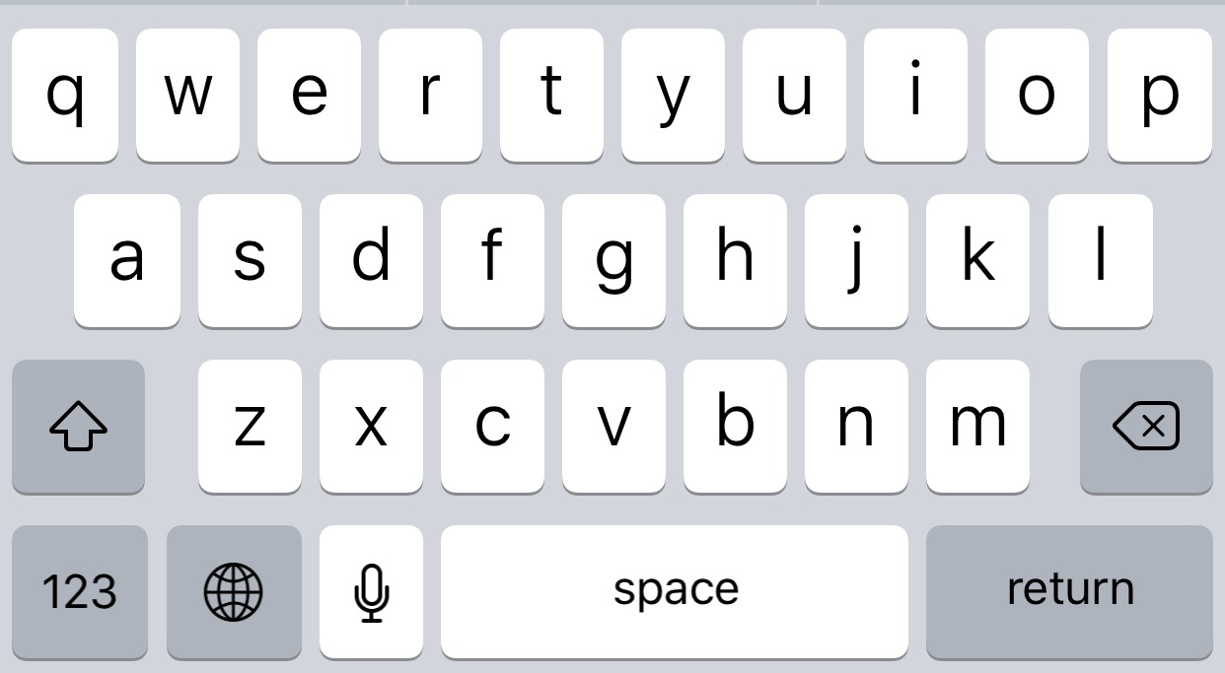
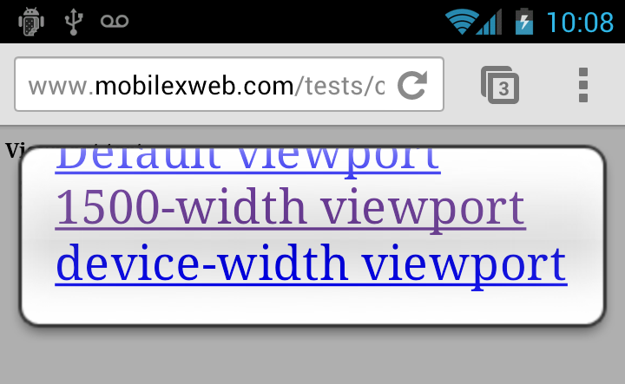
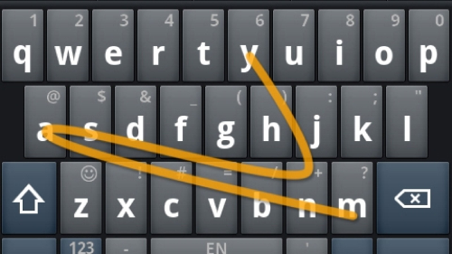
“Beating” Fitts’ Law Next Week
One way of improving performance

Slide 53
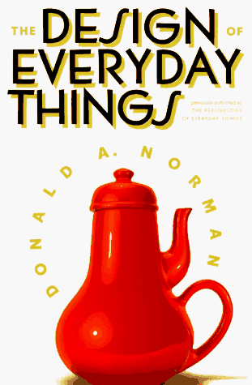
Design of Everyday Things
By Don Norman
UCSD, Apple, HP, NN Group
Illustrates problems faced by designers of systems
Explains conceptual models
Doors, washing machines, digital watches, telephones
Resulting design guidelines

Slide 54
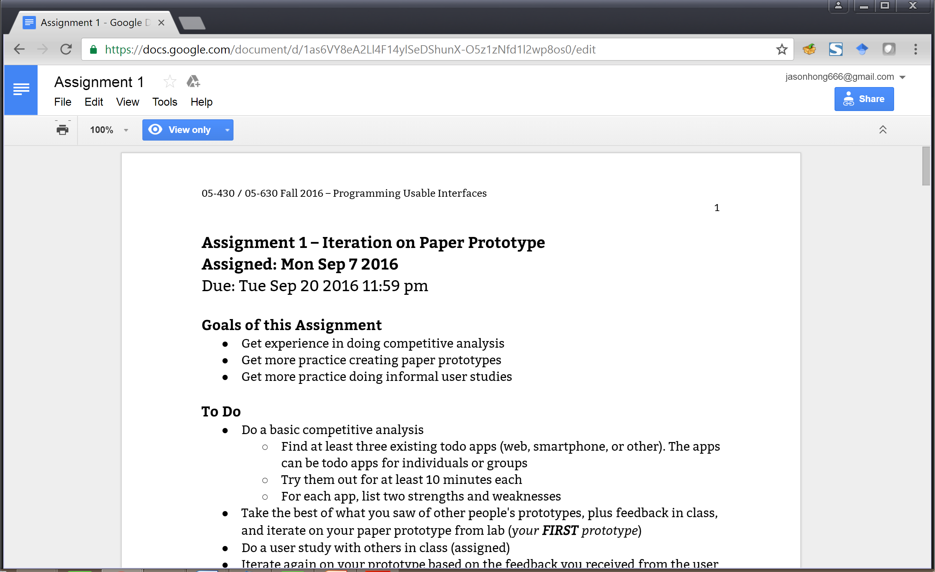
The Interface Cycle
I want to add a thin black box around the title

Slide 55
The Interface Cycle
Display
SYSTEM
Updates display

Slide 56
The Interface Cycle
Display
USER
Evaluates and understands display
SYSTEM
Updates display

Slide 57
The Interface Cycle
Display
USER
Evaluates and understands display
Formulates goals and actions
SYSTEM
Updates display

Slide 58
The Interface Cycle
Display
USER
Evaluates and understands display
Formulates goals and actions
Acts to produce inputs
SYSTEM
Updates display
Input Devices

Slide 59
The Interface Cycle
Display
USER
Evaluates and understands display
Formulates goals and actions
Acts to produce inputs
SYSTEM
Updates display
Interprets input events
Input Devices

Slide 60
The Interface Cycle
Display
USER
Evaluates and understands display
Formulates goals and actions
Acts to produce inputs
SYSTEM
Updates display
Updates internal state
Interprets input events
Input Devices

Slide 61
Norman’s Gulfs
Norman describes two user activities bridging users and systems
The Gulf of Evaluation
Gap between user’s understanding of system and actual system state
User
System

Slide 62
Norman’s Gulfs
Norman describes two user activities bridging users and systems
The Gulf of Evaluation
Gap between user’s understanding of system and actual system state
The Gulf of Execution
Gap between user’s desires and how to do it
So, another perspective on UX design is to shrink these “gulfs”
User
System

Slide 63
Example of the Gulfs
I want to add a thin black box around the title

Slide 64
Example of the Gulfs
User understands & evaluates display
Pretty easy to see no black box around text yet
Compare editing web page in text editor
Might miss that document is in View Only mode

Slide 65
Example of the Gulfs
User understands & evaluates display
Pretty easy to see no black box around text yet
Formulates goals and actions
Add a black box
Acts to produce inputs
Too many buttons / menus
Don’t know how to get out of View Only
Don’t know about tables

Slide 66
Summary
Good and Bad Use of Color
Understand basics of eye structure, rods / cones
Color blindness (rough % and most common type)
Five design tips
Fitts’ Law
Intuition of what it is (bigger / closer targets easier)
Implications for usability
Gulf of Evaluation and Execution
What they are, why they might happen, design

Slide 67
Bad and Good Use of Color
Why is the left’s color choice poor? What makes the right side better?
Notes:
So why is the color choice poor?
No mapping of color (note on right how blues are used for water, and greens for land)
Color is better if you adjust by saturation (purity) or value (brightness) rather than hue (rough color, ie red, green, blue, orange) for mapping. People can more easily see and compare differences in saturation and value over hue. Also, changes in hue don’t naturally map to a scale, whereas saturation and value do.
There is tons more to know about good use of color. For not, the simplest thing to do is to look for existing color palettes, and just those. That should account for the vast majority of your needs for colors. There is also red-green color blindness too. Simplest thing to do is to turn your screens into greyscale, and see if you can see differences.

Slide 70
What Kinds of Design Problems Can Lead to Big Gulf of Evaluation?
Your thoughts?
Display orientation or text direction
Complicated onboarding / concepts user has to know
Bad categorization / bad labeling
User
System
Notes:
From 2016
Poor contrast / hard to see important things
Lack of feedback
Presenting options that are out of context
Ex. Editing table but shows shapes / clutter
No screen
Hidden modes
Unfamiliar design patterns

Slide 71
What Kinds of Design Problems Can Lead to Big Gulf of Execution?
Your thoughts?
User
System
Notes:
From 2016
Too much nesting / menu options hidden
Illogical menu tree
Contextual menus / showing relevant controls
Not knowing where to start
Unfamiliar symbols / Adobe suite tools
Unexpected behaviors / hard to predict
Illogical mappings
Unclear capabilities
Multiple commands / multiple ways to do it
Breaks convention
Hidden commands /
Inconsistency

Slide 72
Some Causes of Gulf of Evaluation
Hard to understand visual feedback
Poor use of colors
Bad layout, poor grouping
Unfamiliar display of information
Unfamiliar design patterns, or doesn’t follow convention
Forcing people to remember lots of things
Lack of feedback in response to inputs
Might not see visual updates
Can’t find info on screen
Might look same as unimportant
Irrelevant info on screen / important info missing

Slide 73
Some Causes of Gulf of Execution
Unfamiliar devices and inputs
Don’t know what is possible
Unfamiliar GUI widgets
Solvable with experience
Unfamiliar interaction patterns
Also solvable with experience
Example patterns: Dialogs, Shopping Carts

Slide 75
